Slide 1











Sponsors

Slide 2

Eight hours of work in 20 minutes
Magnus Ahlkvist

Slide 3


Language

Slide 4
About Magnus Ahlkvist
39
Statistics Sweden
SQL Server for 15 years
MCSA SQL Server 2012
Father of Freja (7) and Malte (3)
Slow (and somewhat overweight) runner
Twitter: @OnlySql
LinkedIn: http://se.linkedin.com/in/magnusahlkvist
Magnus.ahlkvist@vansterpartiet.se

Slide 5
Before we begin…

Slide 6
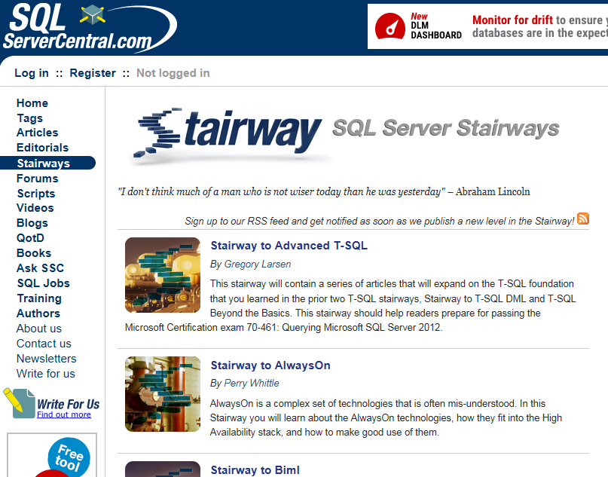
www.sqlservercentral.com

Slide 7
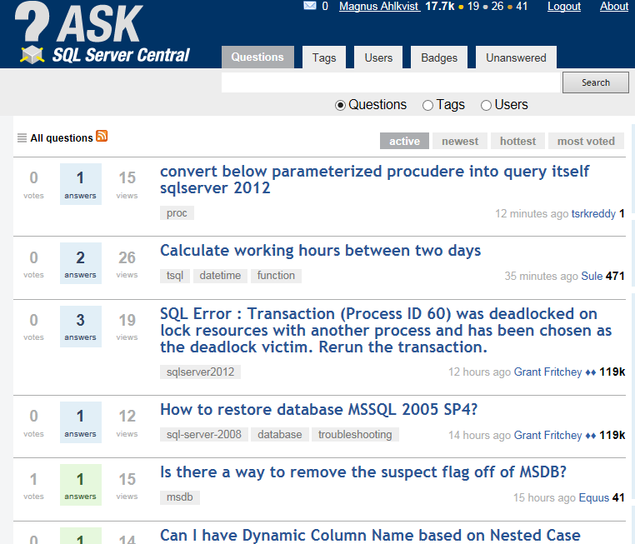
ask.sqlservercentral.com

Slide 8
This presentation will NOT
...demonstrate Best Practice in any way
…demonstrate how to use SSIS
…teach anyone about data modelling
…demonstrate how to use Entity Framework

Slide 9
This presentation WILL
…say some things about a real world scenario.
…show common mistakes (so you can avoid them yourself)
…talk about partitioning data in SQL Server
…talk about some not so obvious behaviour in Entity Framework

Slide 10
Let’s go!

Slide 11
The case
Someone implemented a monthly data load.
10-12 million rows of financial securities data from CSV-files.
70 columns
Initially no indexes, but querying requirements changed => now 20 indexes.
This session => smaller dataset, but same idea.
2 million rows of data (Warehouses, cost of buying products, gross and net sales, Items sold etc).
15 (ish) columns
Indexes on some classification columns

Slide 12




DEMONSTRATION!

Slide 13
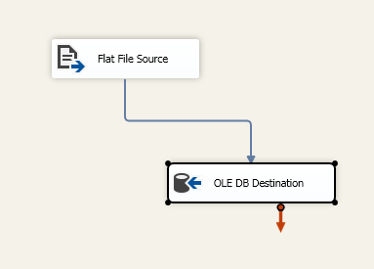
Version 1
Create SSIS-package to load the data

Slide 14
Performance of v1
 | ID | Status | Duration (sec)
 | 23 | Succeeded | 184,076
 | 22 | Succeeded | 62,424
 | 21 | Succeeded | 31,179

Slide 15
Why?
After the first execution, someone decided to add a unique constraint
ALTER TABLE Demo.ProductionSales ADD CONSTRAINT [UQ_DEMO_ProductionSales] UNIQUE NONCLUSTERED
(
ReferenceDate ASC,
ProductIdentification ASC,
WarehouseIdentification ASC,
ProductionCompanyIdentifier ASC
)WITH(DATA_COMPRESSION=PAGE) ON [PRIMARY]

Slide 16
Why?
And after the second execution, someone addes some indexes, because users complained about bad query performance.
CREATE INDEX ix_ProductIdentification ON DEMO.ProductionSales(ProductIdentification)WITH(DATA_COMPRESSION=PAGE) ON [PRIMARY];
CREATE INDEX ix_ItemType ON DEMO.ProductionSales(ItemType) WITH(DATA_COMPRESSION=PAGE) ON [PRIMARY];
CREATE INDEX ix_ProductionCompanyIdentifier ON DEMO.ProductionSales(ProductionCompanyIdentifier)WITH(DATA_COMPRESSION=PAGE) ON [PRIMARY];
CREATE INDEX ix_ProductionCurrency ON DEMO.ProductionSales(ProductionCurrency)WITH(DATA_COMPRESSION=PAGE) ON [PRIMARY];
CREATE INDEX ix_ProductionCountry ON DEMO.ProductionSales(ProductionCountry)WITH(DATA_COMPRESSION=PAGE) ON [PRIMARY];
CREATE INDEX ix_WarehouseIdentification ON DEMO.ProductionSales(WarehouseIdentification)WITH(DATA_COMPRESSION=PAGE) ON [PRIMARY];
CREATE INDEX ix_WarehouseLocation ON DEMO.ProductionSales(WarehouseLocation)WITH(DATA_COMPRESSION=PAGE) ON [PRIMARY];
CREATE INDEX ix_SalesCurrency ON DEMO.ProductionSales(SalesCurrency)WITH(DATA_COMPRESSION=PAGE) ON [PRIMARY];

Slide 17
Second attempt
The reason for bad performance was the indexes. So I decided to disable indexes and rebuild them after loading data.

Slide 18
DEMONSTRATION!

Slide 19
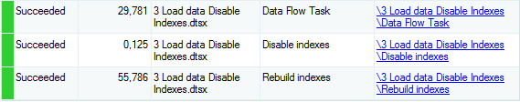
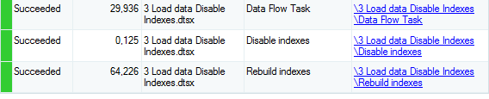
Execution time of Version 2
First execution: 86 seconds
Second execution: 94 seconds

Slide 20
My production scenario
Table have 250 million rows
Load performance has degraded, from two-three hours to eight hours
Users are upset
I’m sad ☹
Almighty Kimberly Tripp’s whitepaper about partitioning

Slide 21
Partitioning
Table based partitioning
Find key(s) to partition the data on
Physically stored as ”separate tables”
Logically kept together
Clustered index must have partition key in it
Data is switched from staging table to partitioned table. Staging table must:
have same columns as target table
have same indexes as target table
have a check constraint which ensures all rows ”fit” into a partition
Target table target must:
have an empty partition
reside on the same filegroup as the staging table
have all its indexes created on the partition schema (aligned)

Slide 22
Partitioning, objects
Partitioning is defined by a partition function
Each partitioned table is stored on a partition scheme
Partition schemes are built on one or more filegroups

Slide 24
Partition function
Name of partition function
Input-parameter-datatype
Range direction (LEFT/RIGHT)
Range values
If RANGE RIGHT is used, values equal to or greater than a range value is placed in the partition ”to the right of” the range value. If RANGE LEFT is used, values equal to or smaller than a range value is placed in the partition ”to the left of” the range value
Example of RANGE RIGHT with int input-parameter-datatype.
PARTITION 1 |  | PARTITION 2 |  | PARTITION 3 |  | PARTITION 4
Negative values | 0 | Integer values between 0 and 9 | 10 | Integer values between 10 and 99 | 100 | Integer values larger than or equal to 100

Slide 25
DEMONSTRATION!

Slide 26
Let’s partition Demo.ProductionSales

Slide 27
Partitioning key
Each monthly data load has a new ReferenceDate
Always larger than previous load’s ReferenceDate
Could also use ProductionSalesID
Somewhat trickier
Smaller clustered index
I choose ReferenceDate

Slide 28
Clustered index
ReferenceDate must be part of Clustered index
I also keep ProductionSalesID
ever increasing clustering key.
ReferenceDate is first column
Queries will have ReferenceDate in WHERE-clause

Slide 29
Partition function
Partition function uses Input-parameter-datatype date
ReferenceDate is date-datatype
RANGE RIGHT
No obvious reason…
Range values
Each already existing ReferenceDate from the table
Plus range value of next month’s last day

Slide 30
Partition scheme
All partitions to same filegroup
Allows for fast partition switching
I only have PRIMARY filegroup

Slide 31
Partition the table
Drop clustered index
Recreate clustered index, on Partition Scheme instead of on a Filegroup
Re-create all non clustered indexes, on Partition Scheme
Non clustered indexes must be aligned with table to allow partition switching

Slide 32
Staging table
Create staging table, identical to Demo.ProductionSales

Slide 33
DEMONSTRATION!

Slide 34
Change SSIS-job
Load data to Staging table instead of Demo.ProductionSales
Add code for switching partition

Slide 35
DEMONSTRATION!

Slide 36
Results of version 3
Execution time is now constant, around 55 seconds.
In my production scenario, execution time has dropped to 20 minutes. Performance no longer degrading.
Deleting old months is now a meta-data-only operation.

Slide 37
SWITCH OUT
Clean out some old data
SWITCH from target table to staging table
TRUNCATE staging table
MERGE RANGE (if you want to)

Slide 38
DEMONSTRATION!

Slide 39
Some more words about partitioning
Enterprise edition
Makes index rebuild work in parallell
Enterprise edition speeded up execution from eight hours to 2,5 hours.
SWITCH takes a SCH-M lock on the table
Wait until SCH-S locks are released
Potentially long time before SWITCH will finish
But: SCH-M lock is taken also with index rebuild..
…even with ONLINE = ON.

Slide 40
Querying partitioned table
Many queries will benefit from the table being partitioned
Partition elimination
Some queries will need to be tweaked – otherwise their performance will degrade
Max for example

Slide 41
DEMONSTRATION!

Slide 42
Entity Framework and partitioning
Integer as partitioning key => No problem
Date as partitioning key => Problem
Entity Framework uses DATETIME2(7) instead of date
Implicit datatype conversion to datatype date…
…SQL Server can’t use partition elimination
Can be defined as Date in Entity Framework models…
…LINQ2Entities will still translate it to DATETIME2(7)

Slide 43
Entity Framework, cont
Could use DATETIME2(7) as datatype, instead of date…
…But I don’t want to change datatype in DB

Slide 44
Before we continue with EF-solution
What did the DBA say to the developer?
It doesn’t matter. He wasn’t paying attention anyway.
What did the developer ask the DBA?
It doesn’t matter. The answer was NO.
(I take no credit for these two EXTREMELY funny jokes, I found them on ask.sqlservercentral.com)

Slide 45
Entity framework, cont
When it becomes a problem, developers will have to use ADO.NET and a SqlClient.SqlCommand for executing the query.
DBAs revenge ☺

Slide 46
Questions?

Slide 47
Sponsors

